Slide 1
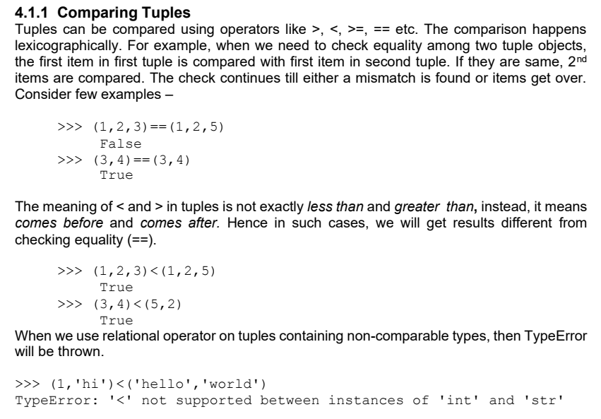

Slide 2
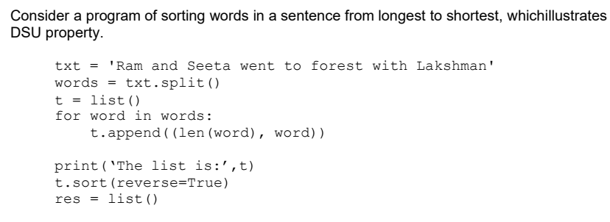

Slide 3
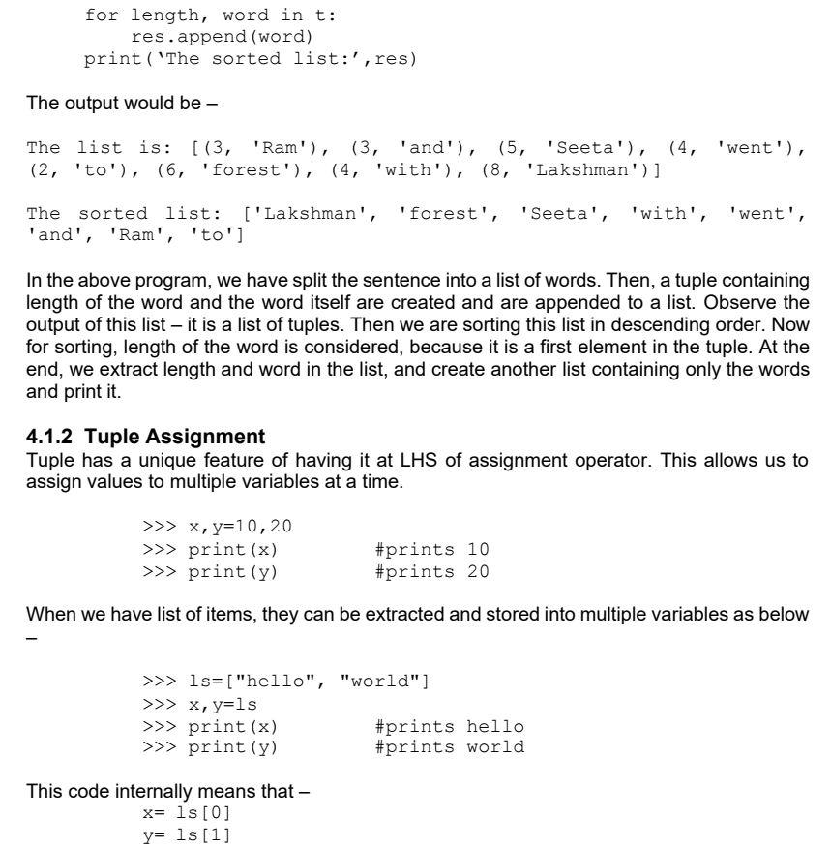

Slide 4
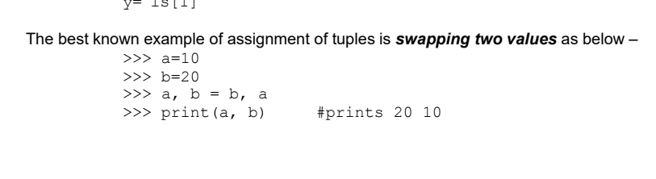

Slide 5
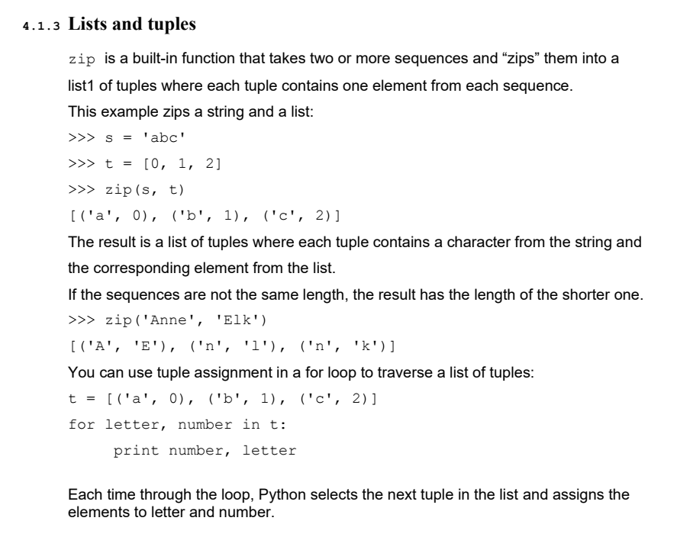

Slide 6
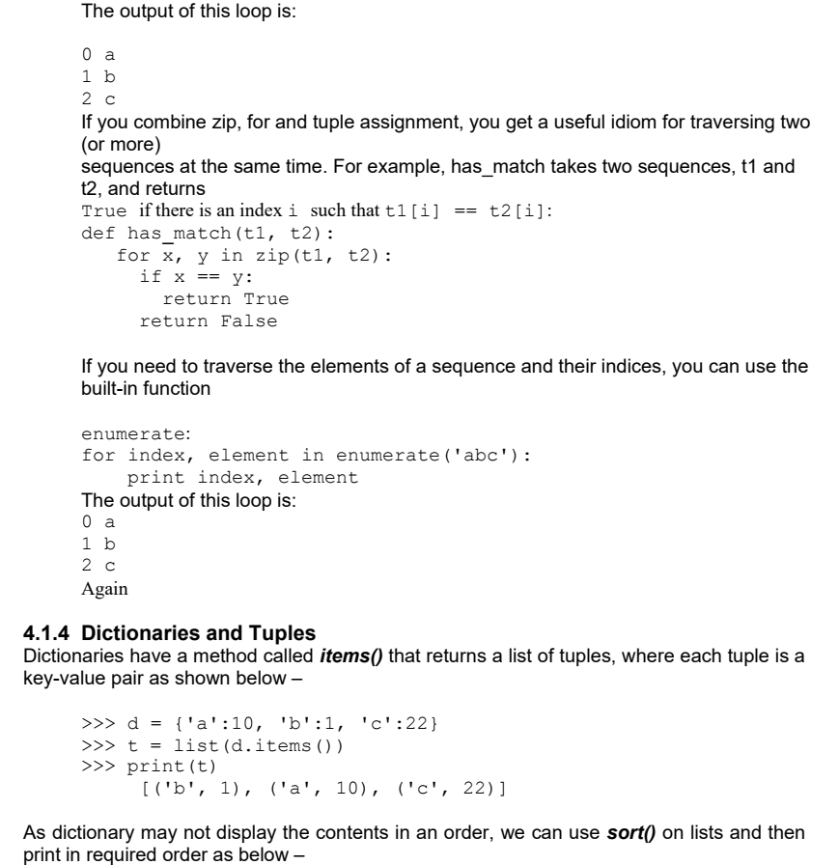

Slide 7
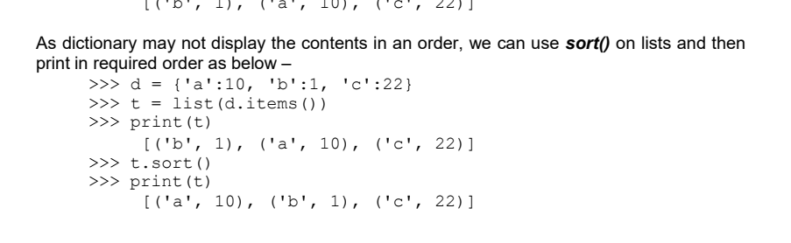

Slide 8
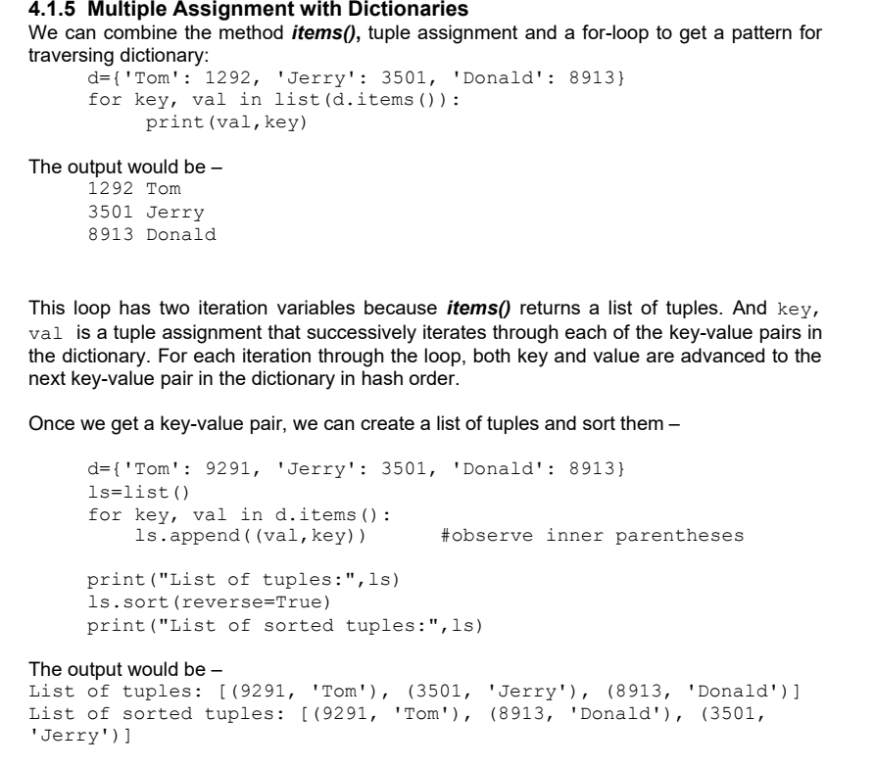

Slide 9
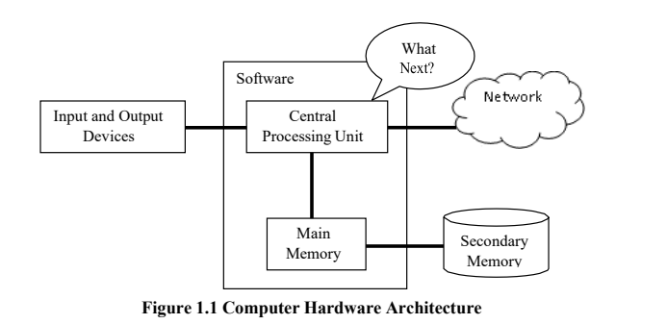
Module 4 – Chapter – 2
FILES

Slide 10
File handling is an important requirement of any programming language, as it allows us to store the data permanently on the secondary storage and read the data from a permanent source.
Here, we will discuss how to perform various operations on files using the programming language Python.

Slide 11
Persistence
The ability to save data or state in a non-volatile storage (like a file or database) so it can be retrieved and used later, even after the program has ended or the computer has shut down.
Common ways to achieve persistence in Python:
Pickling: Serializes Python objects to a file.
Writing to files: Saving data in .txt, .csv, .json, etc.
Databases: Using SQLite, MySQL, etc., to store structured data.
Pickling is the process of converting a Python object into a byte stream (serialization) so that it can be saved to a file or sent over a network. Unpickling is the inverse operation (deserialization).

Slide 12
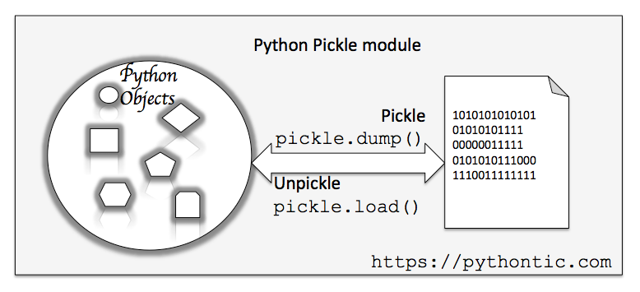
Pickling is the process of converting a Python object into a byte stream (serialization) so that it can be saved to a file or sent over a network. Unpickling is the inverse operation (deserialization).

Slide 13
Opening Files
To perform any operation on a file, one must open a file. File opening involves communication with operating system. The syntax of open() function is as below –
fhand= open(“filename”, “mode”)
Here,
filename is name of the file to be opened. This string may be just a name of the file, or it may include pathname also. Pathname of the file is optional when the file is stored in current working directory
mode This string indicates the purpose of opening a file. It takes a pre- defined
set of values as given in Table 2.1
fhand It is a reference to an object of file class, which acts as a handler or tool for all further operations on files.

Slide 14
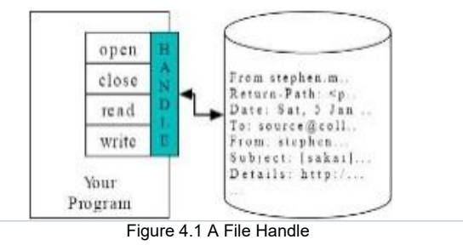
When our Python program makes a request to open a specific file in a particular mode, then OS will try to serve the request. When a file gets opened successfully, then a file object is returned. This is known as file handle and is as shown in Figure 4.1. It will help to

Slide 15
A file opening may cause an error due to some of the reasons as listed below –
File may not exist in the specified path (when we try to read a file)
File may exist, but we may not have a permission to read/write a file
File might have got corrupted and may not be in an opening state

Slide 16
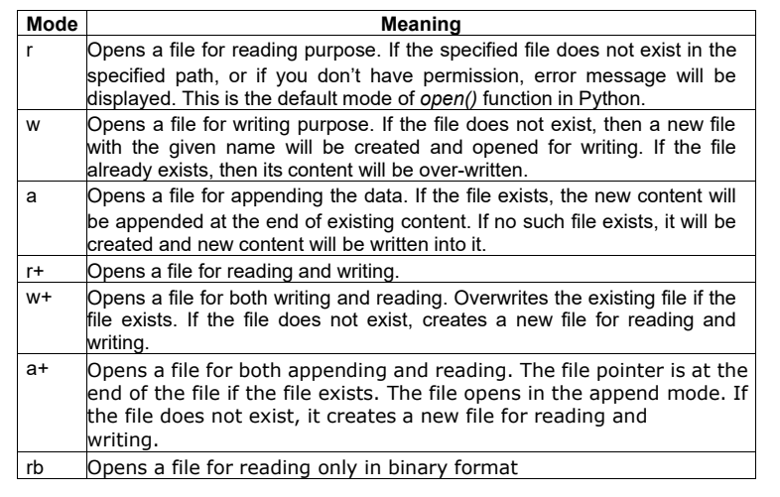

Slide 17
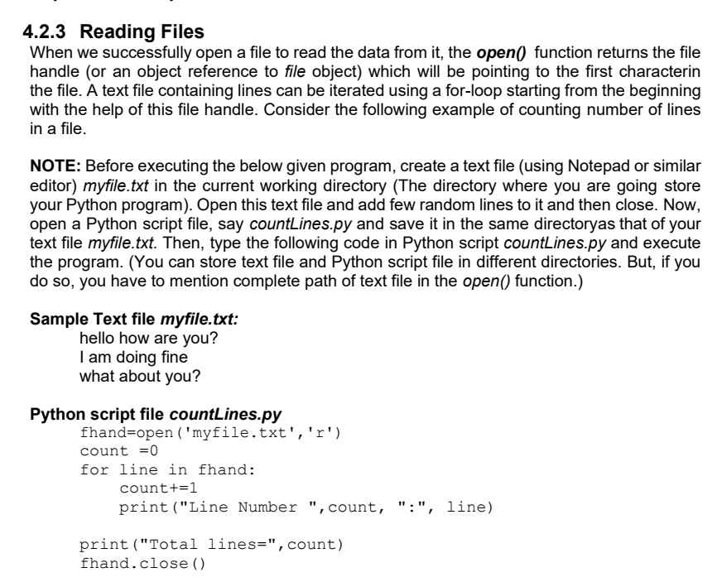

Slide 18
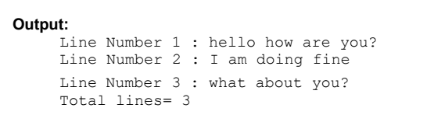


Slide 19

If you run the above program and check the output, there will be a gap of two lines between each of the output lines.
This is because, the new-line character \n is also a part of the variable line in the loop, and the print() function has default behavior of adding a line at the end (due to default setting of end parameter of print()).
To avoid this double-line spacing, we can remove the new-line character attached at the end of variable line by using built-in string function rstrip() as below –
print("Line Number ",count, ":", line.rstrip())

Slide 20

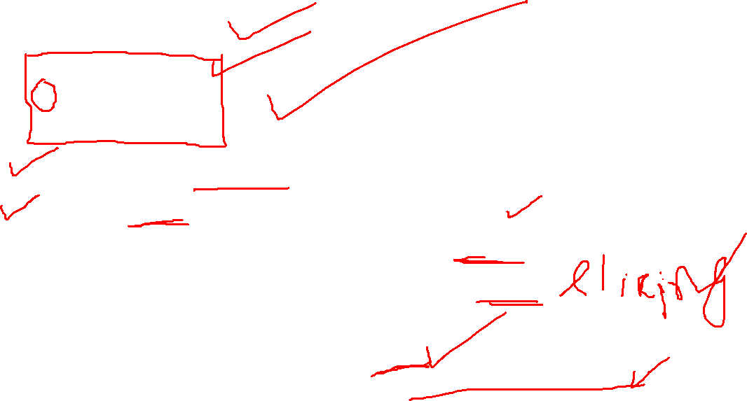
Sample Text file myfile.txt:
hello how are you?
I am doing fine
what about you?
fhand=open('myfile.txt’)
s=fhand.read()
print(“Total number of characters:”,len(s))
print(“String up to 20 characters:”, s[:20])
The output would be –

Slide 21
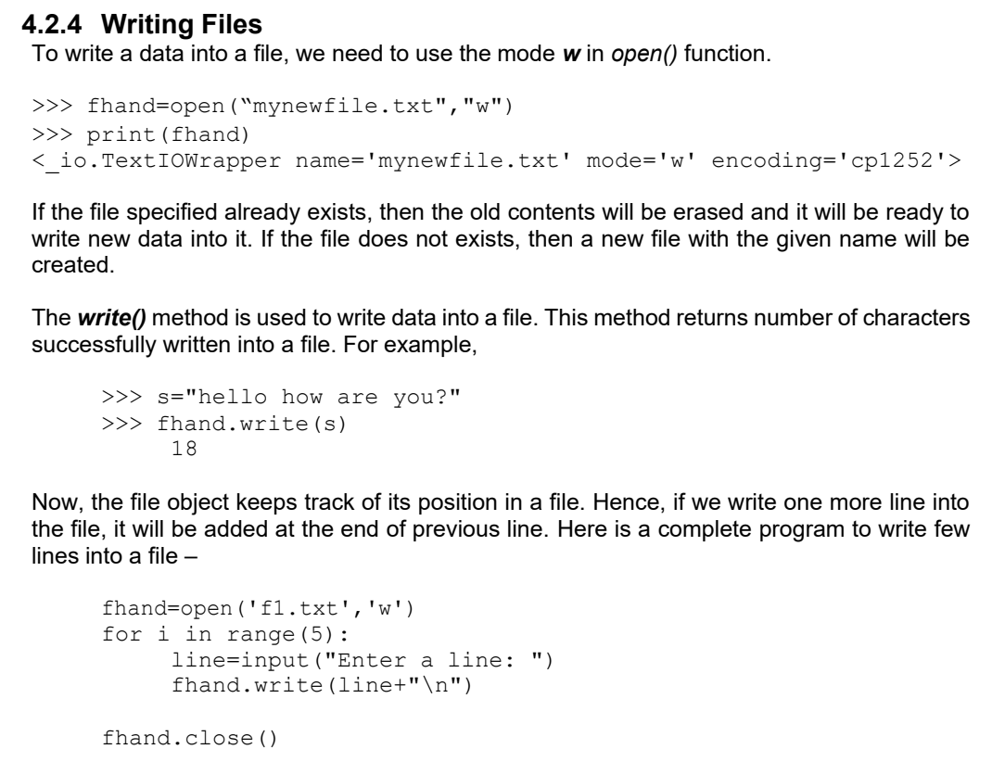

Slide 22
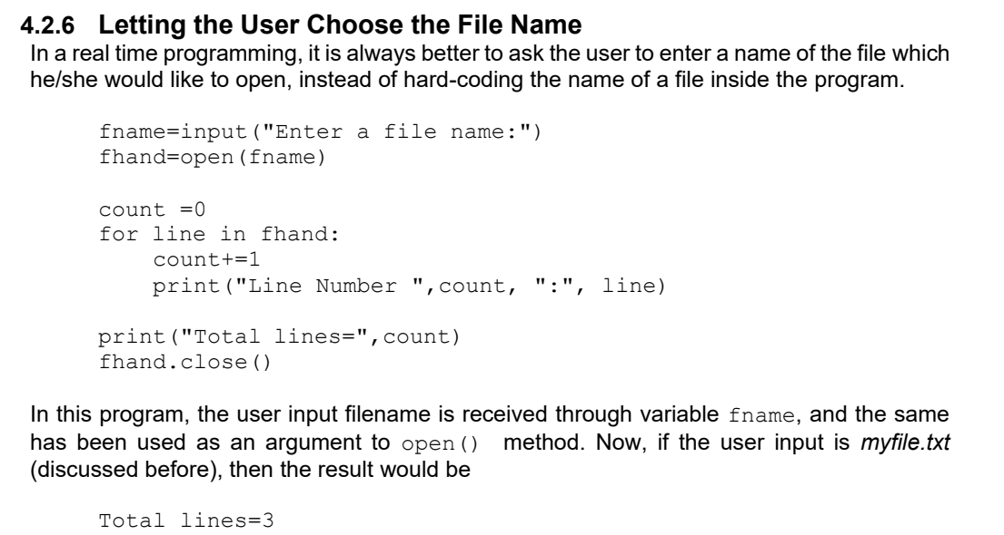

Slide 23
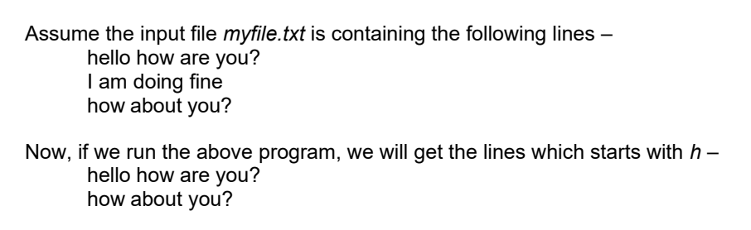
* Searching through a File *
fhand=open('myfile.txt’)
for line in fhand:
if line.startswith('h’):
print(line)
fhand.close()

Slide 24
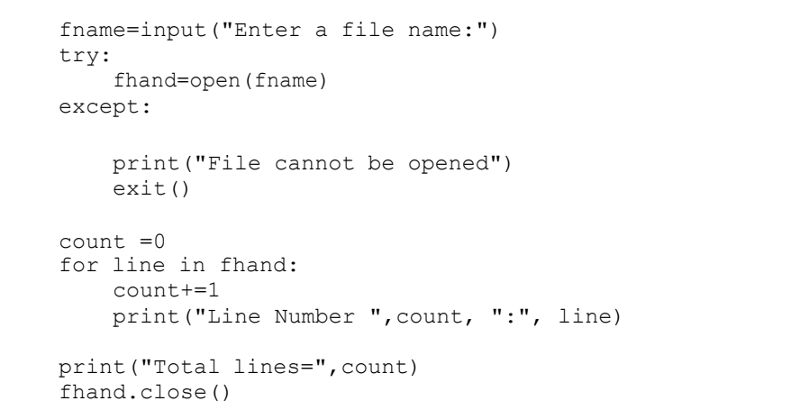
*Using try, except to Open a File*

Slide 25
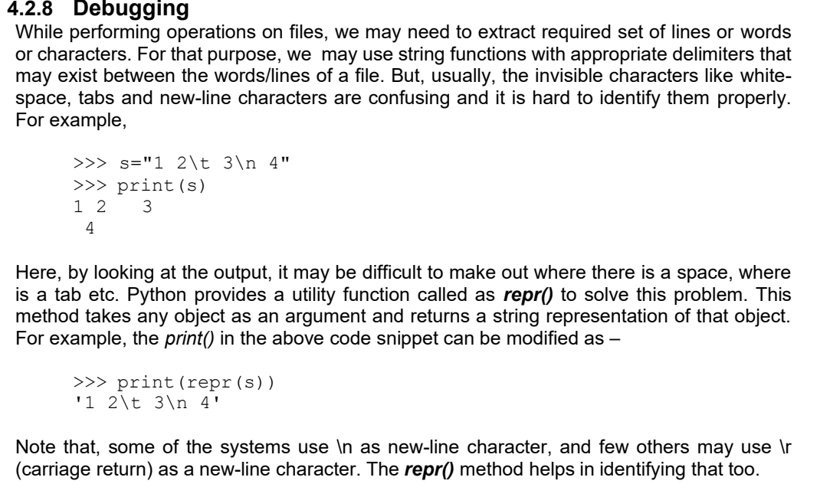

Slide 26
Pickling and Pipes
Pickling is the process of converting a Python object into a byte stream (serialization) so that it can be saved to a file or sent over a network.
Pipes are used for inter-process communication (IPC), allowing two processes to send and receive data between them.
Unpickling is the inverse operation (deserialization).

Slide 27
Using Pickling + Pipe to Send Data Between Processes
Goal:
One process sends a Python dictionary.
It is pickled and sent via a pipe to another process.
The receiving process unpickles and prints the dictionary.

Slide 28
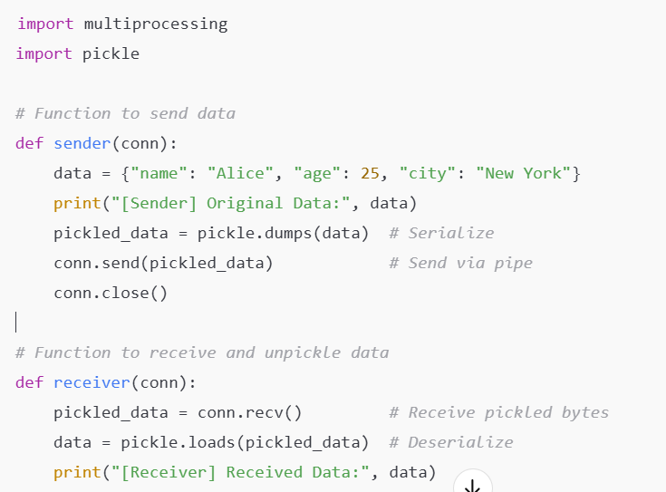
Example - Pickling and Pipes

Slide 29
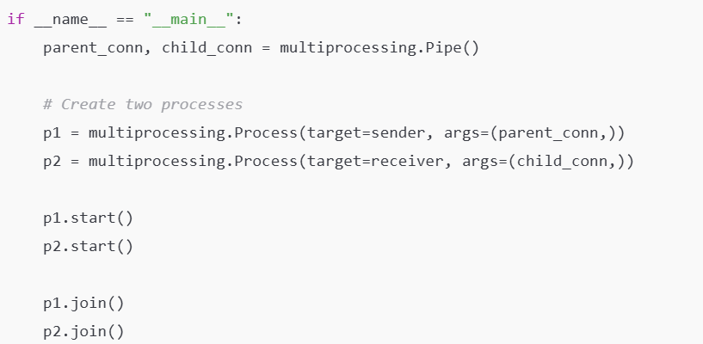
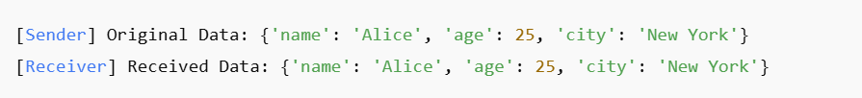
OUTPUT

Slide 30
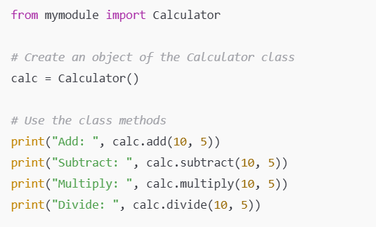
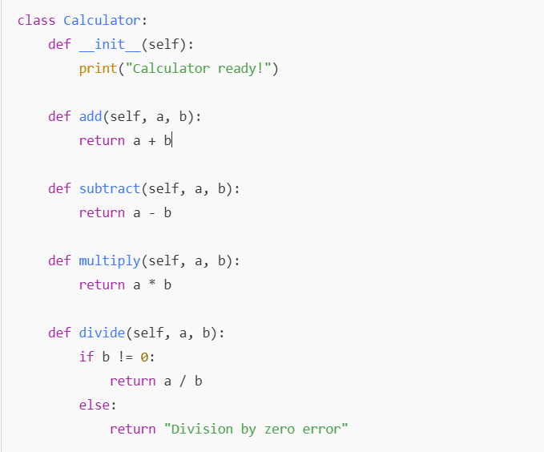
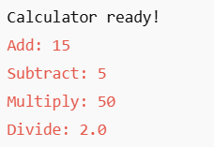
A module in Python is just a file containing Python code (functions, variables, classes) that can be imported and reused in other programs.
*Writing Module*
# mymodule.py
OUTPUT

